Slide 1

Logistic Regression on the Presence of Heart Disease
By Edward Yu

Slide 2

Abstract
1. To investigate which risk factors are under more or less important in determining
an individual’s heart condition.
2. This model can be built into pre-screening applications in which users can test for
their risk of heart disease, supplementing an individual’s regiment of physician
check-ups and overall health and body consciousness.
3. Aid physicians more mathematically and precisely define risk percentages for their
patients, particularly for patients who have mixed heart condition signals.

Slide 3
World’s Growing Problem of Heart Disease
Heart and cardiovascular disease is the leading cause of death worldwide, accounting for approximately 17.3 million deaths/year.
In the U.S. alone this problem causes directly and indirectly $320.1 billion in medical costs and lost productivity.
The global cost of cardiovascular disease is estimated to be $863 billion.
In 2013, cardiovascular deaths represented 31% of all global deaths.

Slide 4
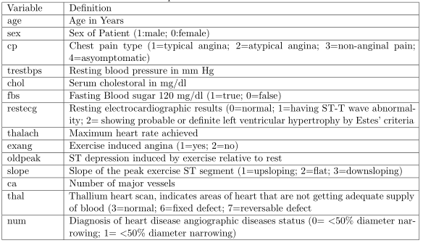
Data Set Variables and Description
This project uses UCI machine learning repository’s Heart Disease Data Set.
‘num’ is the dependent variable, all other variables are regressors.
4 regional data sets:
Cleveland Clinic Foundation
Hungarian Institute of Cardiology, Budapest
V.A. Medical Center, Long Beach, CA
University Hospital, Zurich, Switzerland

Slide 5
Data Wrangling
Data was uploaded into R via text files, all data sets were already in TIDY structure.
Regional data sets were row binded together and totaled 916 observations.
‘num’ variable is an integer valued absence (value 0) to presence(values 1-4). Values > 0 were coded as 1, thus creating two levels “Presence” and “Absence” of heart disease.
‘dsetid’ variable was made to denote which data set an observation came from.

Slide 6
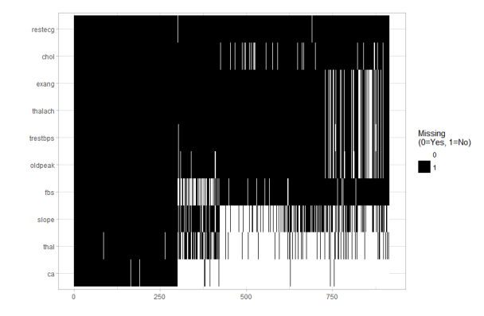
Missing Values pt1.
A total of 12.74% of the data was missing.
Breakdown by variable of the missing observations.
Slope, thal, and ca have 33.62%, 66.37%, and 52.72% missing data respectively. These variables were removed from the data due to systematic missingness of data.

Slide 7
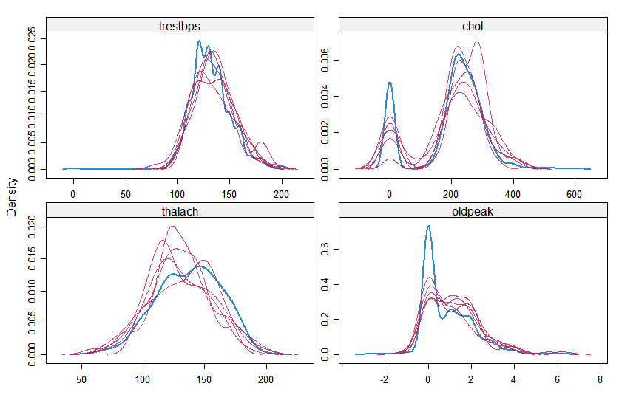
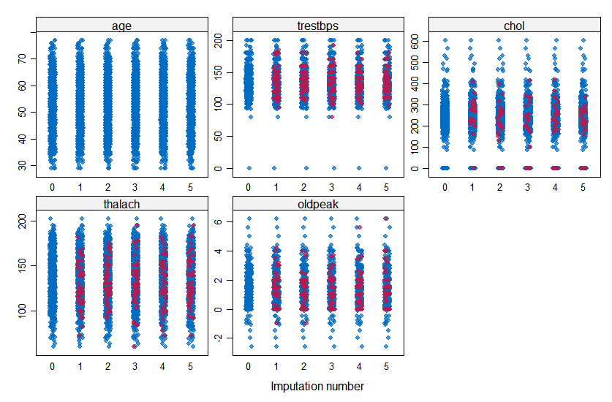
Missing Values pt2.
Density graph of Imputed Numeric Data shows the distribution of imputed data.
Blue lines represent original data and magenta lines represent imputed data.
Blue and magenta dots overlapping indicate that the imputed values are close to the expected real values in distribution.

Slide 8
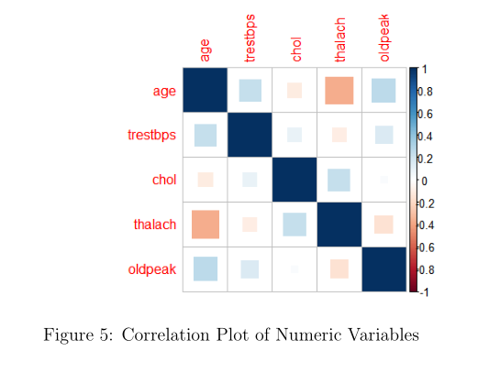
Correlation Plots
Numerical variables were separated from categorical variables from the data set.
From the plot, no real strong correlation between any of numeric variables.
Some weak correlations between age and trestbps, age and old peak, and chol and thalach.

Slide 9
Model Selection
Starting with 916 observations in the finalized ‘heartDT’ data set.
75% of the data was split to the training data set and 25% to the testing set.
LASSO regularization will be tested against Forward and Backwards Stepwise Regression method.
Test of performance goal will be predictive accuracy.

Slide 10
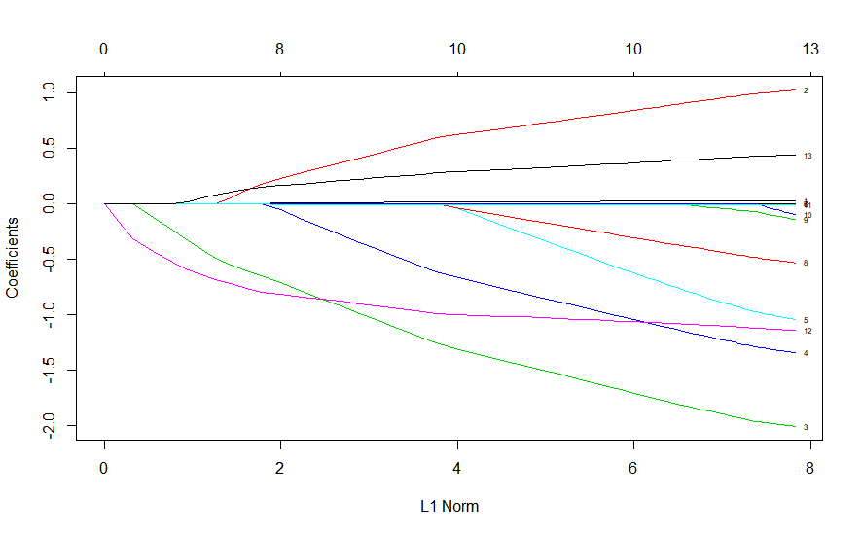
LASSO Method
The LASSO method is a way of both variable selection and regularization and offers a parsimonious model by constraining the magnitude of the coefficients, thus making the model simpler and more elegant.
Each curve corresponds to a variable within the model, including each categorical factor with a total of 13 variables. The path of the curve shows its coefficient against the L 1 norm as λ varies.
When λ is small the LASSO regularization term, L 1 norm , the LASSO solution is similar to OLS solution retaining all coefficients. In contrast, a large λ value will penalize coefficients highly, increasing the regularization reducing the parameters to zero ending up with an underfit model.

Slide 11
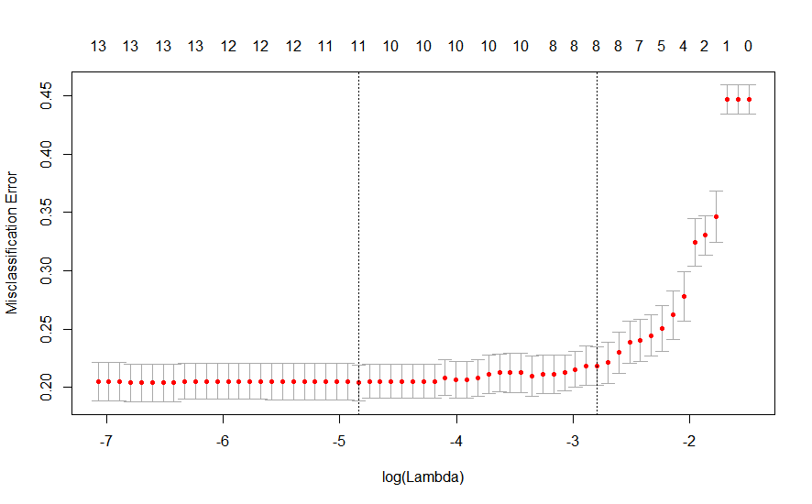
LASSO Method pt2.
Controlling for the λ value is essential formanaging the complexity of the model.
Cross-validation is used to select the most optimal λ . In choosing a correct value we will consider the end goal of prediction accuracy.
Cv.glmnet function performs cross-validation selecting a lambda that minimizes cv error, which also minimizes prediction error.
The two black dotted lines represent the lambda_min and lambda_1se

Slide 12
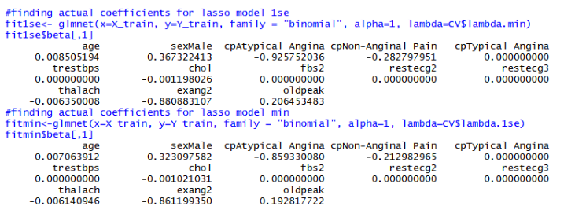
LASSO Results pt1.
The final formula for the logistic regression equation is denoted in the log equation, beta coefficients are listed under each variable.
In interpreting the model, e.g., holding all other variables at a fixed value, the odds of the presence of heart disease if a patient is male rather than female is e^(.323)=1.381.

Slide 13
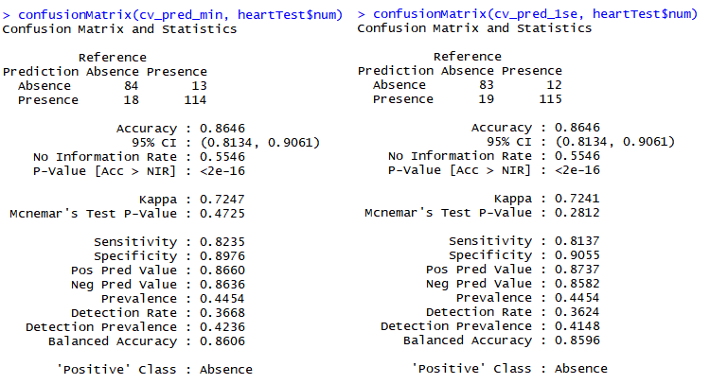
LASSO Results
Testing prediction for both lambda_min = .00789 and lambda_1se = .00611, we receive prediction accuracies of 86.46%
The sensitivity of using lambda_min is slightly higher and specitifity is slightly lower than using lambda_1se

Slide 14
Stepwise Regression
Forward model begins by starting with a null model, then steps upwards by adding the most significant variable to the model.
Backward model begins by starting with a full model, then steps backwards by removing the least significant variable in the model.
AIC criteria is used to test the performance of the models.

Slide 15
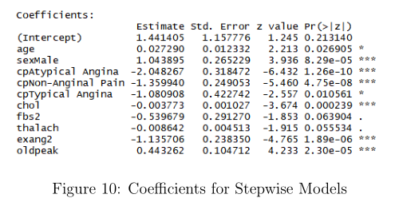
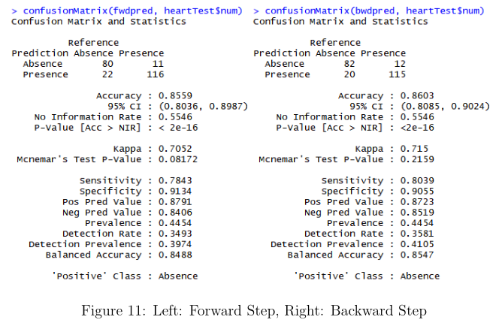
Forward and Backward Regression
The AIC criteria was 614.4 for the final models of both forwards and backwards model.
The same variables were selected at the end of the step selection process.
Running the confusion matrix we saw that accuracy was higher for the backwards model.

Slide 16
Model Conclusion
The primary point of model comparison between LASSO and Stepwise regression methods is prediction accuracy.
The LASSO method performed slightly better than the Stepwise regression methods. Considering the subset of features within this data set was fairly small with a total of 13 variables, the LASSO regularization method did not have as much of a chance to shine.
The LASSO method finds its strength where p >> n . p , representing the number of features
One inherent weakness of L1 regularization is that it tends to do poorly on variable sets with high levels of multicollinearity by often selecting a group of highly correlated variables. However, as we have seen there is not a high level
of correlation amongst the numeric variables of this particular data set, thus is not a significant issue here.
Regarding the condition of heart disease, the most significant contributor seems to be sexMale having the largest coefficient of 0.323 within the LASSO model. Other indicates such as oldpeak, representing ST depression is often a sign of myocardialischemia, which is the lack of blood supply to the heart.

Slide 17
Next Steps and Improvements
Improve understanding on LASSO regression and mathematics behind it.
Go in more depth on other regularization techniques and compare those models.
Add more predictor variables so LASSO becomes more effective.

